Slide 1

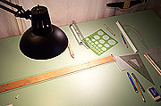

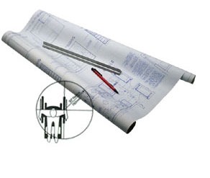
Lecture 2 Basic Geometry

Slide 2
To Bisect a Line
1. Swing two arcs of any radius greater than half-length of the line with the centers at the ends of the line.
2. Join the intersection points of the arcs with a line.
3. Locate the midpoint.
Given
A
A
r₁
r₁
B
B
(not to scale)

Slide 3
To Bisect an Angle
1. Swing an arc of any radius whose centers at the vertex.
2. Swing the arcs of any radius from the intersection points between the previous arc and the lines.
3. Draw the line.
A
(not to scale)
Given
A
B
r₁
r₂
B
r₂
C
C

Slide 4
To draw the line parallel to a given line and passes through a given point
Given
C
+

Slide 5
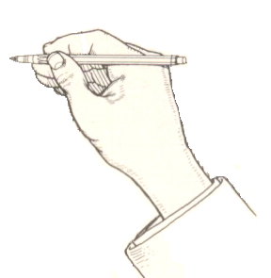
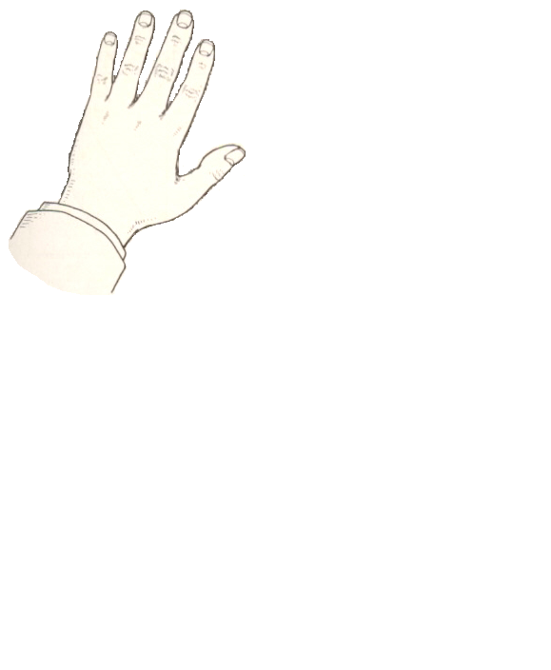
To draw the line parallel to a given line
and passes through a given point
Given
C
+
Repeat

Slide 6
To draw the line parallel to a given line
with a specified distance
Given distance = r
r

Slide 7
To draw the line parallel to a given line
with a specified distance
Given distance = r
r
Repeat

Slide 8
To draw the line perpendicular to a
given line at a given point
Revolve method
C
+

Slide 9
To draw the line perpendicular to a
given line at a given point
Revolve method
C
+
Repeat

Slide 10
To draw the line perpendicular to a
given line at a given point
Adjacent-sides method
C
+

Slide 11
To draw the line perpendicular to a
given line at a given point
Adjacent-sides method
C
+
Repeat

Slide 12
To draw the line perpendicular to a
given line at a given point
Using Compass
+
C

Slide 13
To draw the line perpendicular to a
given line at a given point
Using Compass
r₂
D
r₂
r₁
A
+
r₂ > r₁
C
B
Repeat

Slide 14
Problem 22:
To draw a regular polygon, given the length of its side.

Slide 15
Problem 22:
To draw a regular polygon, given the length of its side.

Slide 16
Problem 22:
To draw a regular polygon, given the length of its side.

Slide 17
Problem 22:
To draw a regular polygon, given the length of its side.

Slide 18
Problem 22:
To draw a regular polygon, given the length of its side.

Slide 19
Problem 22:
To draw a regular polygon, given the length of its side.

Slide 20
Problem 22:
To draw a regular polygon, given the length of its side.

Slide 21
Problem 22:
To draw a regular polygon, given the length of its side.

Slide 22
Problem 22:
To draw a regular polygon, given the length of its side.

Slide 23
Problem 22:
To draw a regular polygon, given the length of its side.

Slide 24
Problem 22:
To draw a regular polygon, given the length of its side.

Slide 25
Problem 22:
To draw a regular polygon, given the length of its side.

Slide 26
Problem 22:
To draw a regular polygon, given the length of its side.

Slide 27
Problem 22:
To draw a regular polygon, given the length of its side.

Slide 28
Problem 22:
To draw a regular polygon, given the length of its side.

Slide 29
Problem 22:
To draw a regular polygon, given the length of its side.

Slide 30
Problem 22:
To draw a regular polygon, given the length of its side.

Slide 31
Problem 22:
To draw a regular polygon, given the length of its side.

Slide 32
Problem 22:
To draw a regular polygon, given the length of its side.

Slide 33
Practise
Assignment Exercise Examples 1,2,3,5,6,7,8,10,11,13,14,16,23,24,25,26,29,30,35,36,37.

Slide 34
DIAGONAL SCALES
Decimal Based Diagonal Scale
To measure dimensions in 1/100th of an inch.

Slide 35
DIAGONAL SCALES
Decimal Based Diagonal Scale
To measure dimensions in 1/100th of an inch.

Slide 36
DIAGONAL SCALES
Decimal Based Diagonal Scale
To measure dimensions in 1/100th of an inch.

Slide 37
DIAGONAL SCALES
Decimal Based Diagonal Scale
To measure dimensions in 1/100th of an inch.

Slide 38
DIAGONAL SCALES
Decimal Based Diagonal Scale
To measure dimensions in 1/100th of an inch.

Slide 39
DIAGONAL SCALES
Decimal Based Diagonal Scale
To measure dimensions in 1/100th of an inch.

Slide 40
DIAGONAL SCALES
Decimal Based Diagonal Scale
To measure dimensions in 1/100th of an inch.

Slide 41
DIAGONAL SCALES
Decimal Based Diagonal Scale
To measure dimensions in 1/100th of an inch.

Slide 42
DIAGONAL SCALES
Decimal Based Diagonal Scale
To measure dimensions in 1/100th of an inch.

Slide 43
DIAGONAL SCALES
Decimal Based Diagonal Scale
To measure dimensions in 1/100th of an inch.

Slide 44
DIAGONAL SCALES
Decimal Based Diagonal Scale
To measure dimensions in 1/100th of an inch.

Slide 45
DIAGONAL SCALES
Decimal Based Diagonal Scale
To measure dimensions in 1/100th of an inch.

Slide 46
Fraction Based Diagonal Scale
To measure dimensions with the least count of 1/64th of an inch or smaller.

Slide 47
Fraction Based Diagonal Scale
To measure dimensions with the least count of 1/64th of an inch or smaller.

Slide 48
Fraction Based Diagonal Scale
To measure dimensions with the least count of 1/64th of an inch or smaller.

Slide 49
Fraction Based Diagonal Scale
To measure dimensions with the least count of 1/64th of an inch or smaller.

Slide 50
Fraction Based Diagonal Scale
To measure dimensions with the least count of 1/64th of an inch or smaller.

Slide 51
Fraction Based Diagonal Scale
To measure dimensions with the least count of 1/64th of an inch or smaller.

Slide 52
Fraction Based Diagonal Scale
To measure dimensions with the least count of 1/64th of an inch or smaller.

Slide 53
Fraction Based Diagonal Scale
To measure dimensions with the least count of 1/64th of an inch or smaller.

Slide 54
Fraction Based Diagonal Scale
To measure dimensions with the least count of 1/64th of an inch or smaller.

Slide 55
Fraction Based Diagonal Scale
To measure dimensions with the least count of 1/64th of an inch or smaller.

Slide 56
Fraction Based Diagonal Scale
To measure dimensions with the least count of 1/64th of an inch or smaller.

Slide 57
Fraction Based Diagonal Scale
To measure dimensions with the least count of 1/64th of an inch or smaller.

Slide 58
Fraction Based Diagonal Scale
To measure dimensions with the least count of 1/64th of an inch or smaller.

Slide 59
Diagonal scale with the least count of 1/128th of an inch

Slide 60
Diagonal scale with the least count of 1/128th of an inch

Slide 61
Diagonal scale with the least count of 1/128th of an inch

Slide 62
Diagonal scale with the least count of 1/128th of an inch

Slide 63
Diagonal scale with the least count of 1/128th of an inch

Slide 64
Diagonal scale with the least count of 1/128th of an inch

Slide 65
Diagonal scale with the least count of 1/128th of an inch

Slide 66
Reading Assignment:
Types of Machine drawings (page # 25 N.D Butt 50th Edition
Assignment # 1
Solved Problems # 4.3, 4.4, 4.7 (page # 53, 55 N.D Butt 52th Edition)
Exercise IV
Problem # 10, 11, 13 (page 67 N.D Butt 52th Edition)

Slide 67
Assignment 2
Draw a regular pentagon and hexagon with side length 4cm

